Slide 1

International Conference on Signal
Processing, Information, Communication and
Systems 2025 (SPICSCON 2025)
Date: 21-22 November, 2025
BanglaMM-Disaster: A Multimodal Transformer-Based Deep Learning Framework for Multiclass Disaster Classification in Bangla
Authors: Ariful Islam¹, Md Rifat Hossen¹, Md. Mahmudul Arif¹, Abdullah Al Noman², Md Arifur Rahman³
Affiliations: ¹Chittagong University of Engineering and Technology, Bangladesh ²Wilmington University, USA ³Trine University, USA
Paper ID. 122

Slide 2
Overview
Problem Statement & Motivation
Dataset & Disaster Categories
Multimodal Methodology
Experimental Results
Conclusions & Future Work

Slide 3

Problem Statement & Motivation
The Challenge
Why Multimodal?
Bangladesh faces frequent natural disasters.
Text alone misses visual context.
Massive multilingual social media data during disasters.
Images alone lack situational details.
Bangla lacks robust disaster classification tools.
Combining both improves accuracy.
Need for rapid, accurate disaster identification.
Research Gap: Limited multimodal classification for low-resource Bangla.

Slide 4

Research Objectives
1
2
Create Bangla Multimodal Dataset
Develop Multimodal Framework
5,037 text-image pairs across 9 disaster categories.
Transformer-based text, CNN-based image encoders, early fusion.
3
Evaluate Performance
Compare model combinations and state-of-the-art approaches.
Target: Improve disaster response through automated social media monitoring.

Slide 5

Dataset Overview: BanglaMM-Disaster
9 Disaster Categories
Dataset Statistics
Earthquake (13.87%)
Total samples: 5,037 text-image pairs.
Flood (12.35%)
Source: Social media posts (Facebook, Twitter).
Fire (11.30%)
Landslide (10.66%)
Annotation: Manual labeling by native Bangla speakers.
Drought (10.49%)
Cyclone (10.03%)
Split: 70% training, 10% validation, 20% testing.
Pandemic (9.27%)
Humanitarian Crisis (11.14%)
Key Features
Balanced class distribution.
Irrelevant (10.89%)
Real-world social media content.
Authentic Bangla language usage.

Slide 6
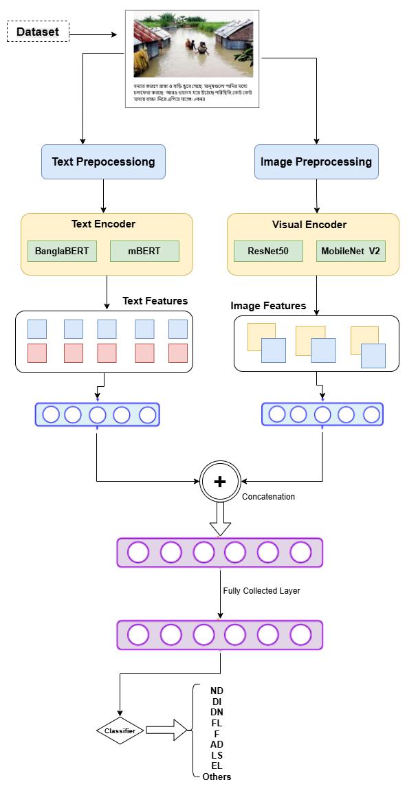



Proposed Methodology: System Architecture
Text Processing
Image Processing
Bangla text input, preprocessing, then BanglaBERT, mBERT, XLM-RoBERTa for feature embeddings.
Disaster images input, preprocessing, then ResNet50, DenseNet169, MobileNetV2 for feature embeddings.
Multimodal Fusion
Early fusion (concatenate text + image features), fully connected layers, Softmax classification (9 classes).

Slide 7

Model Configurations
Text Encoders
BanglaBERT: Pre-trained on Bangla corpus, 110M parameters.
mBERT: Multilingual BERT, 172M parameters.
XLM-RoBERTa: Cross-lingual model, 270M parameters.
Image Encoders
ResNet50: Residual networks, 25.6M parameters.
DenseNet169: Dense connections, 14.1M parameters.
MobileNetV2: Lightweight architecture, 3.5M parameters.
Training Configuration
Optimizer: Adam (LR: 1e-5 text, 1e-4 images).
Batch size: 32.
Epochs: 20 with early stopping.
Loss function: Categorical cross-entropy.

Slide 8
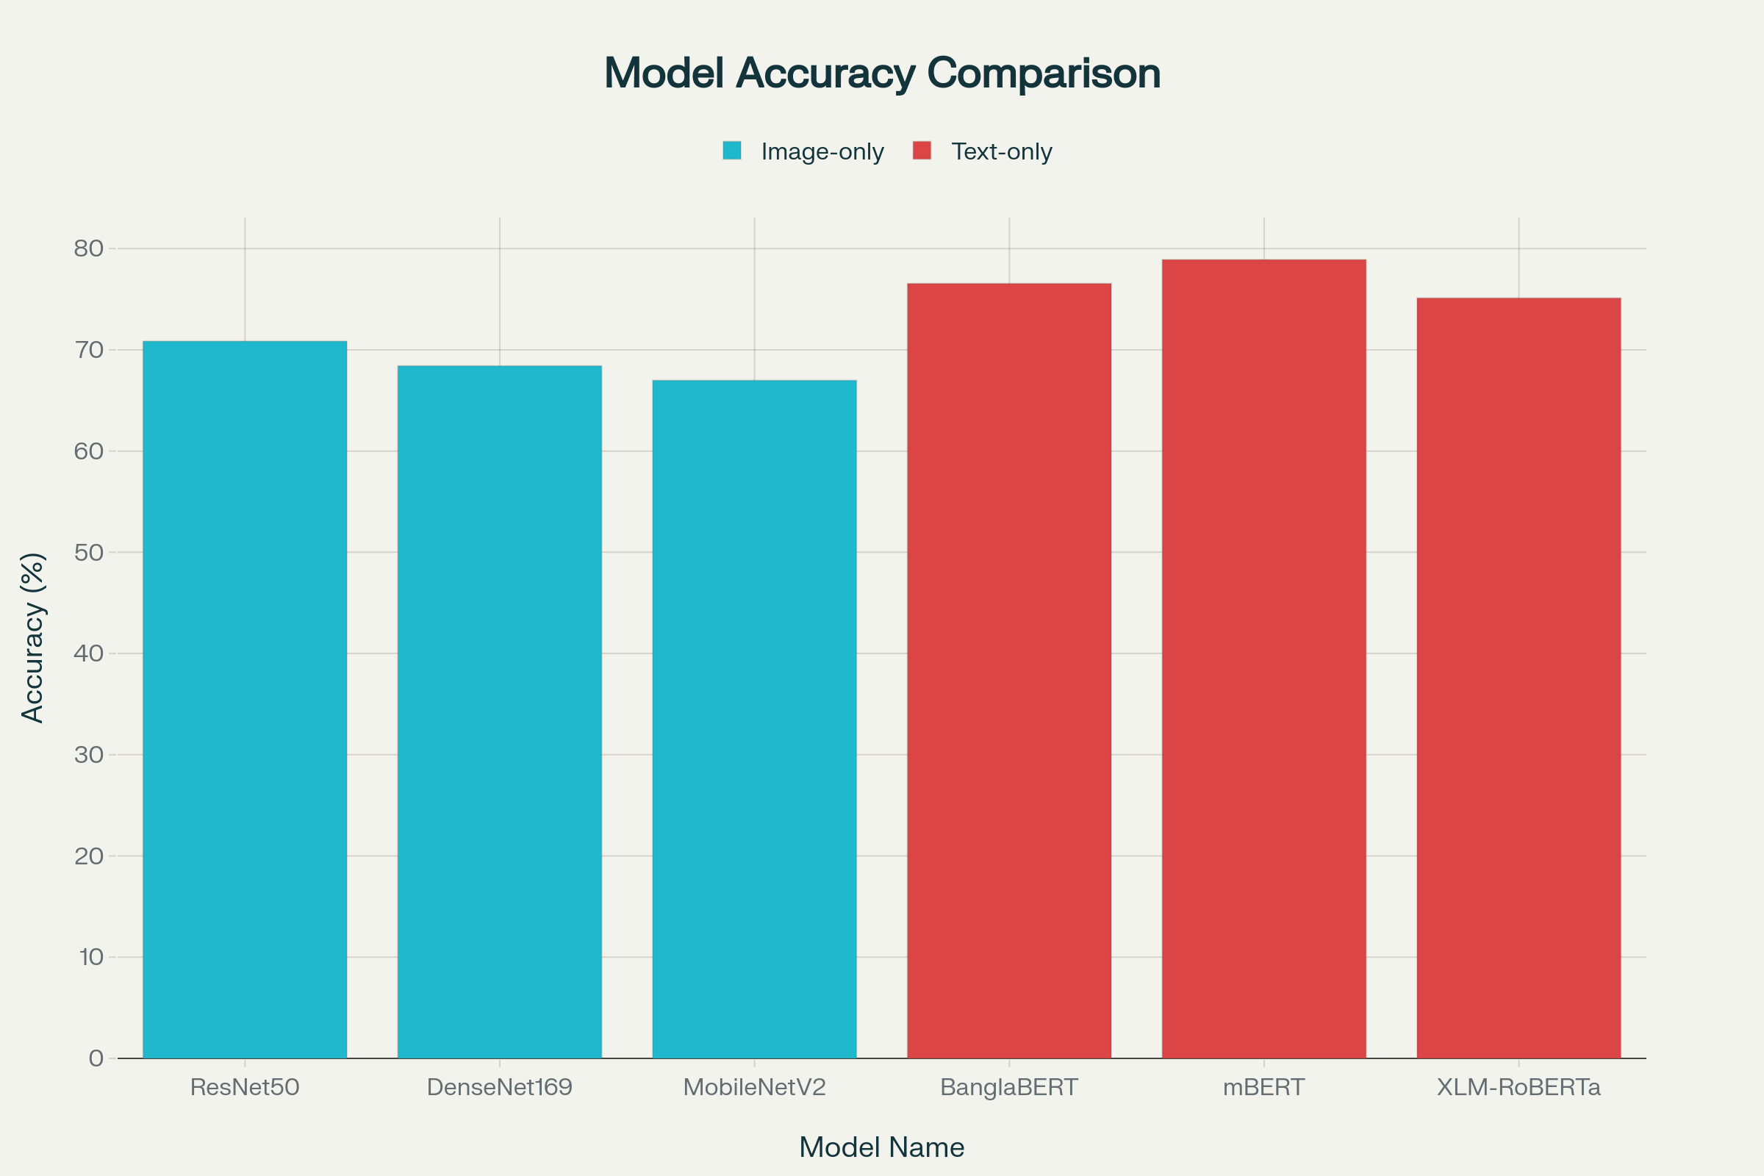
Experimental Results: Unimodal Performance
Image-Only Models
Key Observation
ResNet50: 66.85% accuracy
Text models generally outperform image-only models. mBERT shows the strongest text performance. Visual features alone are insufficient for complex disaster classification.
DenseNet169: 65.47% accuracy
MobileNetV2: 62.41% accuracy
Text-Only Models
BanglaBERT: 76.73% accuracy
mBERT: 78.15% accuracy
XLM-RoBERTa: 79.92% accuracy

Slide 9



Multimodal Fusion Results
mBERT + ResNet50: 83.76%
mBERT + DenseNet169: 82.45%
XLM-RoBERTa + ResNet50: 81.33%
Precision: 84.12%, Recall: 83.76%, F1-Score: 83.89%
Performance Gains
+3.84% over best text-only model.
+16.91% over best image-only model.
Why This Works
Complementary information from text and images. mBERT captures linguistic context, ResNet50 extracts robust visual features.

Slide 10
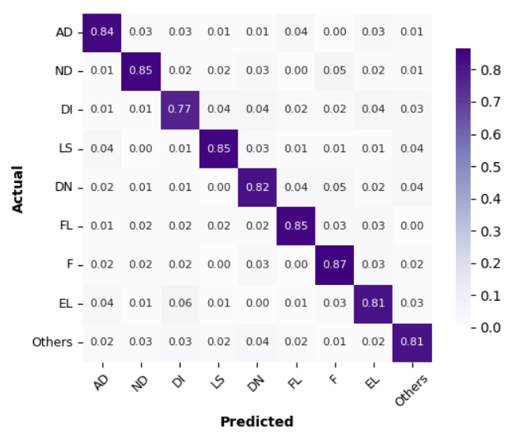
Confusion Matrix Analysis
Key Insights
Strong Performance: Earthquake, Flood, Fire (>85% precision).
Challenging Classes: Humanitarian Crisis vs Pandemic, Drought vs Irrelevant.
Class-wise Accuracy: Best: Earthquake (91.2%), Most challenging: Humanitarian Crisis (76.8%).
Error Analysis
Multimodal fusion reduces misclassification by 23% compared to unimodal approaches.

Slide 11
Comparison with State-of-the-Art
Traditional ML (SVM)
62.4%
CNN-only
68.7%
LSTM-only
71.3%
BERT + CNN (Related work)
79.2%
Our BanglaMM-Disaster
83.76%
Significant Improvement
Tailored for Bangla
Robust Data
+4.56% over previous best methods.
Optimized for the unique characteristics of the Bangla language.
Utilizes a larger, more diverse dataset for training.

Slide 12


Performance Metrics
Computational Efficiency
Model Complexity
197.6M parameters
(mBERT + ResNet50), 1.8 GB size.
Inference Performance
0.45 seconds per sample, suitable for real-time.
Resource Requirements
Training on NVIDIA RTX 3090
(~6 hours).
Scalability
Processes 2,000+ posts/minute for disaster monitoring.

Slide 13

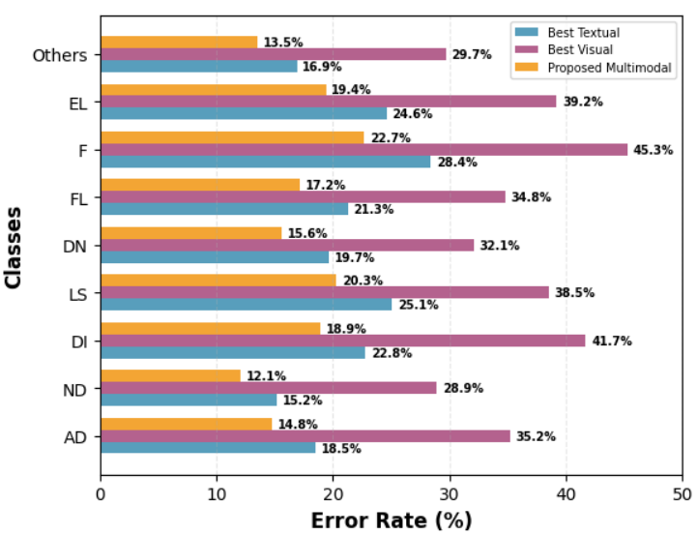
Qualitative Analysis
Success Cases
Clear imagery + explicit disaster mentions yield 95%+ accuracy.
Consistent terminology across text and image.
Failure Cases
Sarcastic/metaphorical language.
Poor quality images or ambiguous contexts.
Model Strengths
Handles code-mixing (Bangla-English).
Robust to social media noise and varied image quality.
Limitations
Struggles with rare disaster types.
Needs more training data for minority classes.

Slide 14





Key Contributions
Novel Dataset
First large-scale Bangla multimodal disaster dataset: 5,037 annotated samples, 9 categories, publicly available.
Multimodal Framework
Transformer + CNN architecture with optimized early fusion,
achieving 83.76% accuracy (SOTA).
Comprehensive Evaluation
Tested 9 model combinations, detailed performance analysis,
and validated computational efficiency.
Real-world Applicability
Fast inference (0.45s), scalable architecture, and deployment-ready
for disaster management.

Slide 15
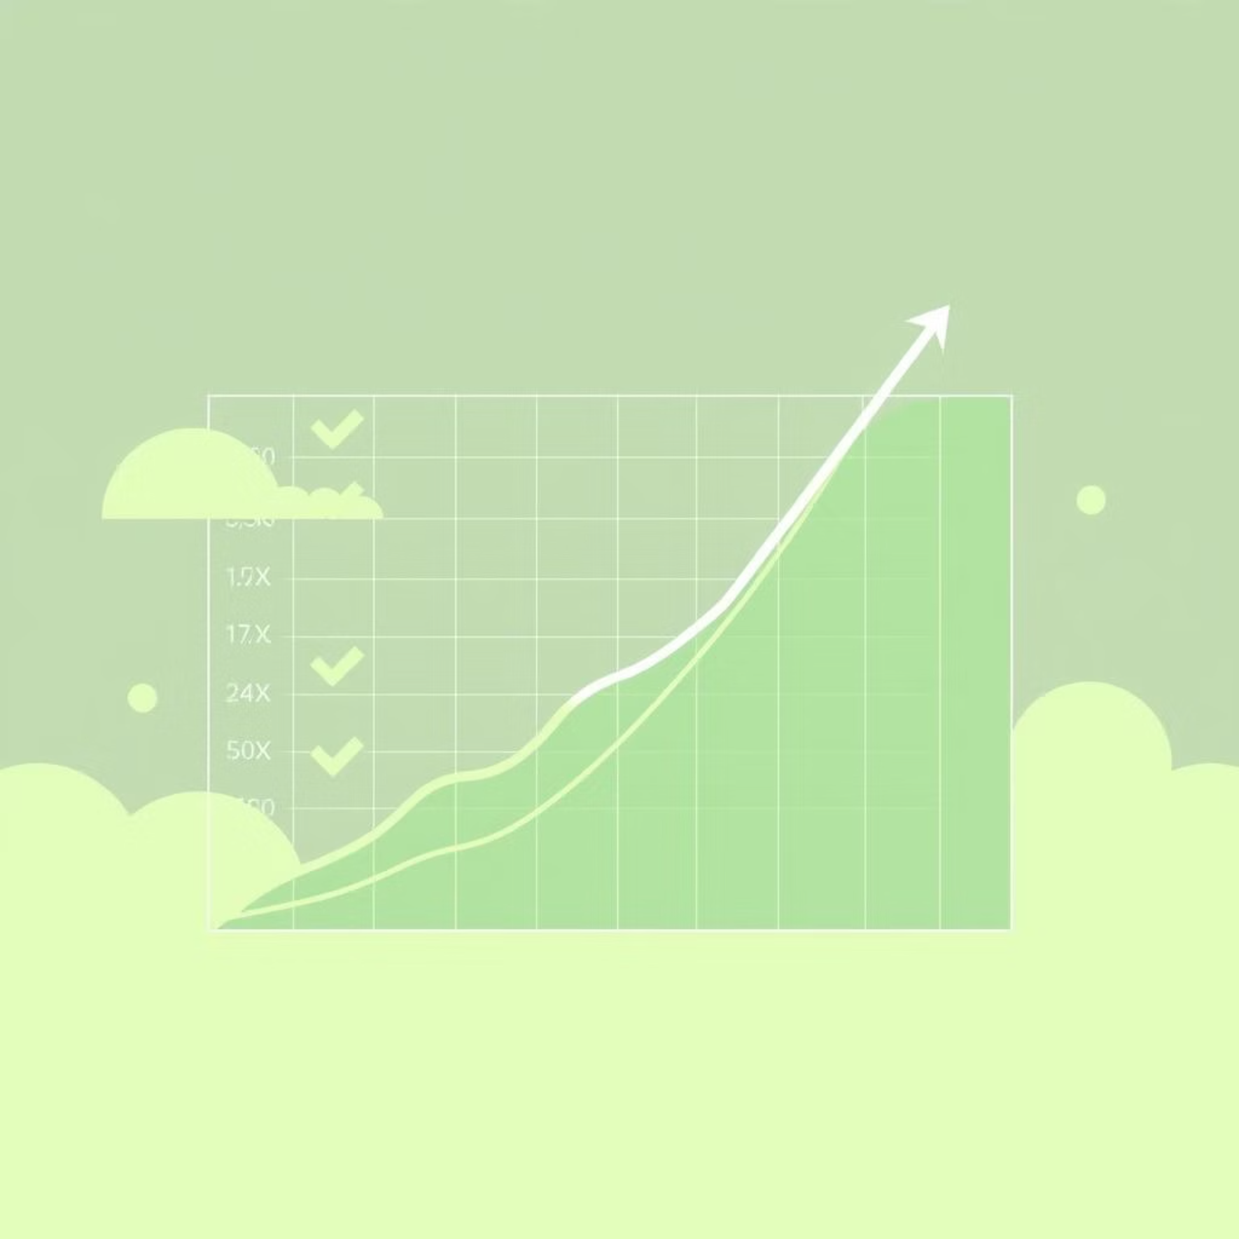
Conclusions & Future Work
Conclusions
Future Research Directions
Developed effective multimodal framework for Bangla disaster
classification.
01
Dataset Expansion
Multimodal approach significantly outperforms unimodal methods
(+3.84%).
Include more disaster types and increase samples for minority
classes.
mBERT + ResNet50 achieves best performance (83.76%).
02
Framework suitable for real-time disaster monitoring.
Model Enhancement
Explore late/hybrid fusion, attention mechanisms, and domain
adaptation.
03
Real-world Deployment
Integrate with disaster management systems, mobile apps, and
multi-language support.
04
Advanced Features
Add temporal analysis, geolocation, and severity classification.

Slide 16

Thank You!
Questions & Discussion
Contact: Md Rifat Hossen, Department of Computer Science and Engineering, Chittagong University of Engineering and Technology
Email: rifat8851@gmail.com
Acknowledgments:
CUET Department of CSE, Dataset annotation team, IEEE SPICSCON 2025 organizing committee.

